Slide 1
Snake battle

Slide 2
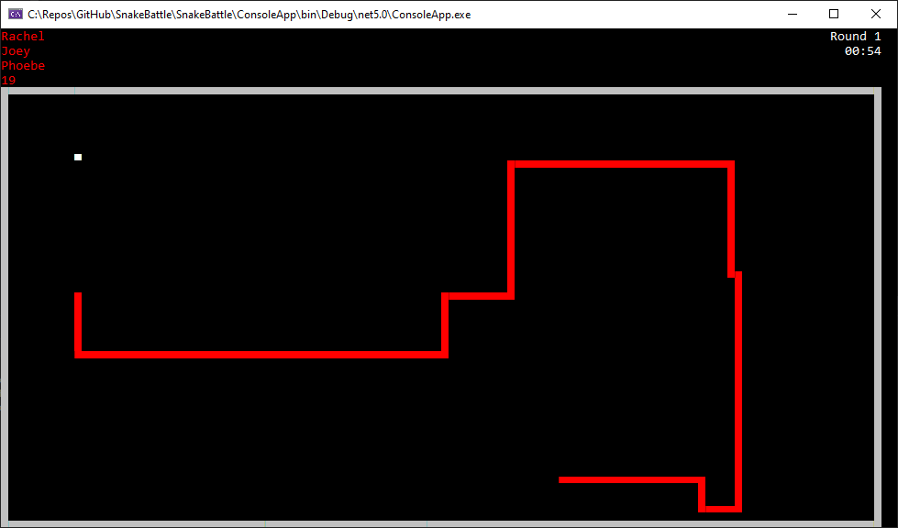

Slide 3
What is Snake battle?
Snake battle is an exercise for practicing teamwork (and coding).
Your task is to develop a CPU player that controls a snake in a classic snake game.
The snake has two goals:
Eat as much food as possible
Stay alive by avoiding obstacles

Slide 4
What is Snake battle?
The repository contains a full snake game, but the snake is just a dummy.
Your job is to make it smart.

Slide 5
How is the exercise organized?
The participants are divided into teams of 2–3 persons.
Each team gathers to implement their snake collaboratively, using one computer per team.
In the end, all the snakes are placed on the same map, and a set of rounds is played. The team whose snake eats most food in total wins.

Slide 6
Rules for the final battle
We’ll play 3 rounds.
A round ends when all snakes have died (or if 1 minute passes without any snake eating food).
The snake who eats most food in total during all the rounds wins.

Slide 7
How to get started with coding?
Follow the instructions in the repository’s README.md file.

Slide 8
Tips
Start simple.
Don’t aim for too advanced solutions. We don’t have time for that.
If your snake doesn’t work as expected, add a breakpoint in your player class and start debugging.
Note that if your player throws an unhandled exception, the game won’t crash, but your snake will just keep going forward silently.
Contact the facilitator if you have technical issues.
Have fun! (The goal is not to compare your coding skills.)

Slide 9
Schedule
The times are in EET
12:00 Introduction
12:10 Group up and start coding
14:40 Push your changes and create a pull request
14:45 Snake battle!

Slide 10
Teams
Team 1 | Team 2 | Team 3 | Team 4 | Team 5 | Team 6 | Team 7

